Slide 1

Reproducibility & Introduction to Jupyter
Jessica Randall, MPH

Slide 2
Take 5 minutes, discuss with your neighbors: What makes a project unreproducible?

Slide 3
Introduction & Background
Undergrad
Global Health
Internships
Peace Corps
Data IRL
Role in global development
Graduate School
Hey, I like math
SAS, Python
Working
Statistics as a lifestyle
Role as a scientist

Slide 4
What is reproducibility?
“Given a population, hypothesis, experimental design, experimenter, data, analysis plan, and code you get the same parameter estimates in a new analysis”
-Patil, Peng, Leek

Slide 5
Case Study:
Population: Children with 3q29deletion
Hypothesis: variance in gene expression among sample group A is the same as variance in gene expression among sample group B (for differential expression analysis)
Experimental Design: 6 cases/6 controls
Experimenter: me and client
Data: counts from sample, information about participants
Data analysis plan: using standard DESeq2 pipeline with default parameters
Code: Available upon request in an R markdown file provided to client

Slide 6
Who bears the cost of bad analysis?
Our data are (or aim to emulate) people and our analysis makes claims about their health
Who are we responsible to?
What if we’re wrong?
Transparency
Advancing methods
Does encouraging reproducibility deter bad analysis?

Slide 7
Examples from your own experience?

Slide 8
DO start with strong science & ethics
Understand the assumptions in your model and use them appropriately
Sound experimental design
If you don’t understand an analysis pipeline, don’t use it until you do
We’re scientists!
Research, Hypothesize, Experiment, Analyze, Communicate
Where does analysis fit in?
Math isn’t magic
Pretty graphs go a long way

Slide 9
DO teach a computer
Programmers are lazy, programs are not
Maybe someone else has already taught the computer
Library documentation
Bioconductor workflows/Support/authors
R for Data Science/ tidyverse
Stack Overflow/Stack Exchange/Biostars/Reddit
Copy paste from yourself
Don’t do things by hand, how will you know what you did?
Double underscores

Slide 10
A Cautionary Tale: Don’t Let Excel Errors Happen to You
Case study: Potti et al., “Genomic Signatures to guide the use of chemotherapeutics, 2006
Using genetic expression profiles to predict response to chemotherapies
Extraordinary claims require extraordinary proof
Retracted in 2011 when findings were found to be the result of an off-by-one Excel error
Excel often converts gene names as dates, 1/5 of published gene lists show these conversions
Replicable is not enough

Slide 11
DO keep track of your software environment
Updating shouldn’t break your code
.Rproj (reading on this)
Jupyter Labs/Notebooks (has similar problems in readings)
sessionInfo()/sinfo()

Slide 12
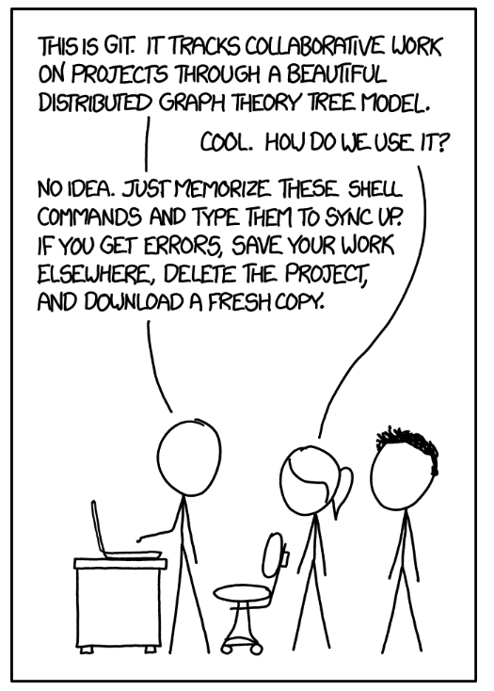
DO use version control
Your most important collaborator is you 6 months from now
Prototyping vs Production code
Github
Best available
Documentation is updated less frequently than code, make code your documentation
Standard practice to include a link to repository for publication even if it only goes in the supplementary documentation
All my materials for this course are available here : https://github.com/jessmrandall/IBS574Spring2020
https://xkcd.com/1597/

Slide 13
To GUI or not to GUI?
Don’t make a fetish of it
Qiime2 for metagenomics
DAVID for proteomics
Start with a GUI or Shiny app but aim to code it yourself so you know how it works
Help others understand why it works and what it’s doing without judgement
Proprietary software is not always transparent software
nanostring for transcriptomics

Slide 14
Summary:
DO
Start with strong science & ethics
Teach a computer
Keep track of your environment
Use version control

Slide 15
Break
Take 10 minutes

Slide 16
Types of Code
Prototyping
Production
Lab notebook
Stream-of-consciousness
Everything you ever tried
Snippets
New ideas
Code copied verbatim from workflows or Stack Overflow
Manual unit tests
Final Report
Works on any machine anywhere
Doesn’t rely on a working directory
Does work in a clean workspace
Passes informal unit tests (dimensions, lengths, values of a row or column, type of data etc)
Human-readable instructions for a machine that describe how inputs become outputs

Slide 17
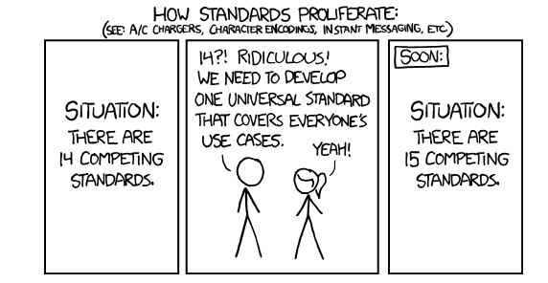
Python vs R
Python is currently losing to R in Bioinformatics
2 lectures and 1 lab on each language
Being multilingual is good, there is no real rivalry
Biopython ≠ Bioconductor, easier to get started with the latter (R)

Slide 18
Jupyter Notebooks
Stands for Julia, Python and R
Compiler
Also runs SAS
Use Anaconda (Python 3.7)
Good for: writing about code, Prototyping, checking graphs
Not Good for: Production
How do you know in what order you ran the cells?

Slide 19

Installation & Walkthrough
Install anaconda, choose Python 3.7
Keep calm and run command line as administrator
conda update –all
conda create -n py38 python=3.8
conda activate python38
pip install watermark
Note: if you have any errors with panda or numpy,
activate conda python38
pip install [insert package name here]
Image credit: https://datarebellion.com/blog/quick-guide-to-installing-anaconda/

Slide 20
Downloading Git and using GitHub
Available for Mac, Windows, and Linux
Basic Git commands for use in the terminal/command line
Alternatively, VS Code with Vim and Git extensions which I what I use

Slide 21
In class practice:
git config - -global user.name Anynameyouwant
git config --global user.email emoryemailaddress@emory.edu
Or setup VSCode with this information
Clone my IBS 574 Github repository and save it wherever you keep materials for this class
Git clone https://github.com/jessmrandall/IBS574Spring2020.git
Git pull https://github.com/jessmrandall/IBS574Spring2020.git
Following Steps can be done in Github Desktop, VSCode with Jupyter Extensions, or in the command line/terminal
Choose Applications on python38, open Jupyter Notebooks, navigate to the Notebook for HW 1
Make a copy of the file HW 1 change file name to Lastname_Firstname_HW1
Add your name in the cell below “Add your name…”
Save and close

Slide 22
Homework
Required:
https://www.amstat.org/ASA/Your-Career/Ethical-Guidelines-for-Statistical-Practice.aspx
https://simplystatistics.org/2017/03/02/rr-glossy/
https://hrdag.org/tech-notes/harmful.html
Create a Github account and clone my repository for this class, assignment submissions should be links to the completed assignment on your repository
Introduction to Python Practice Homework :
1 is Due Feb 4
Documentation for packages in HW 1 :
Watermark
Pandas
Numpy
Sinfo
2 is due Feb 11
3 is due Feb 18
Optional:
https://hrdag.org/2020/01/07/learning-a-modular-auditable-and-reproducible-workflow/ (I wrote this one!)

Slide 23
If curious
Principled Data Processing a talk given by a friend and hero of mine Dr. Patrick Ball
Resources from the Algorithmic Justice League founded by Joy Buolamwini
Git Best Practices from Seth Robertson
Genomic Data Science Specialization taught by Dr. Roger Peng at Johns Hopkins University on Coursera

Slide 24
References
Reproducible Research Johns Hopkins University
Python for Genomic Data Science Johns Hopkins University
The Task is a Quantum of Workflow, Human Rights Data Analysis Group
The Structure and Interpretation of Computer Programs, Massachusetts Institute of Technology
Delphine R. Boulbes, Tracy Costello, Keith Baggerly, Fan Fan, Rui Wang, Rajat Bhattacharya, Xiangcang Ye, L. M. E. (2018). A Survey on Data Reproducibility and the Effect of Publication Process on the Ethical Reporting of Laboratory Research. Clincical Cancer Research, 18(0227). https://doi.org/10.1158/1078-0432
Baggerly, K. A. (2010). The Importance of Reproducibility in High Throughput Biology: Case Studies in Forensic Bioinformatics. https://d18ky98rnyall9.cloudfront.net/_26e6ce51223ccd2d11a3cec15a76ca6a_baggerly.pdf?Expires=1580169600&Signature=AkbbZbGv6lIn9DtOgsXjtcWV1tjbkbjVCCMQxUWioSIUITk83IEjFVtZzi8EQthF9U7xUEz-Mm3klrelJLb11UKDh5UA6CLQji38ubhrk4~fPT2rXPevWgL-6ld1fYNJ3h41woDGWrVa9
Patrick Ball, P. D. (2016). Principled Data Processing. Data & Society Research Institute. https://www.youtube.com/watch?v=ZSunU9GQdcI
Prasad Patil, Roger Peng, J. L. (2017). A Statistical Definition for reproducibility and replicability. BioRxiv. https://doi.org/https://doi.org/10.1101/066803
Sandve, G. K., Nekrutenko, A., Taylor, J., & Hovig, E. (2013). Ten Simple Rules for Reproducible Computational Research. In PLoS Computational Biology (Vol. 9, Issue 10). https://doi.org/10.1371/journal.pcbi.1003285
https://xkcd.com/927/

